Slide 1
Rockbuster Stealth LLC
Online video service strategic plan.

Slide 2
Key Questions
Which movies contributed the most/least to revenue gain?
What was the average rental duration for all videos?
Which countries are Rockbuster customers based in?
Where are customers with a high lifetime value based?
Do sales figures vary between geographic regions?

Slide 3
Movie Contributions to Revenue Gain
Top Contributors:
Weakest contributors:
 | film_id | title | rating | category | ct_of_rentals | rev_of_rentals
1 | 879 | Telegraph Voyage | PG | Music | 25 | 215.75
2 | 1000 | Zorro Ark | NC-17 | Comedy | 28 | 199.72
3 | 973 | Wife Turn | NC-17 | Documentary | 27 | 198.73
4 | 460 | Innocent Usual | PG-13 | Foreign | 26 | 191.74
5 | 444 | Hustler Party | NC-17 | Comedy | 22 | 190.78
 | film_id | title | rating | category | ct_of_rentals | rev_of_rentals
1 | 885 | Texas Watch | NC-17 | Horror | 6 | 5.94
2 | 261 | Duffel Apocalypse | G | Documentary | 6 | 5.94
3 | 635 | Oklahoma Jumanji | PG | New | 6 | 5.94
4 | 335 | Freedom Cleopatra | PG-13 | Comedy | 5 | 5.95
5 | 718 | Rebel Airport | G | Music | 7 | 6.93

Slide 4

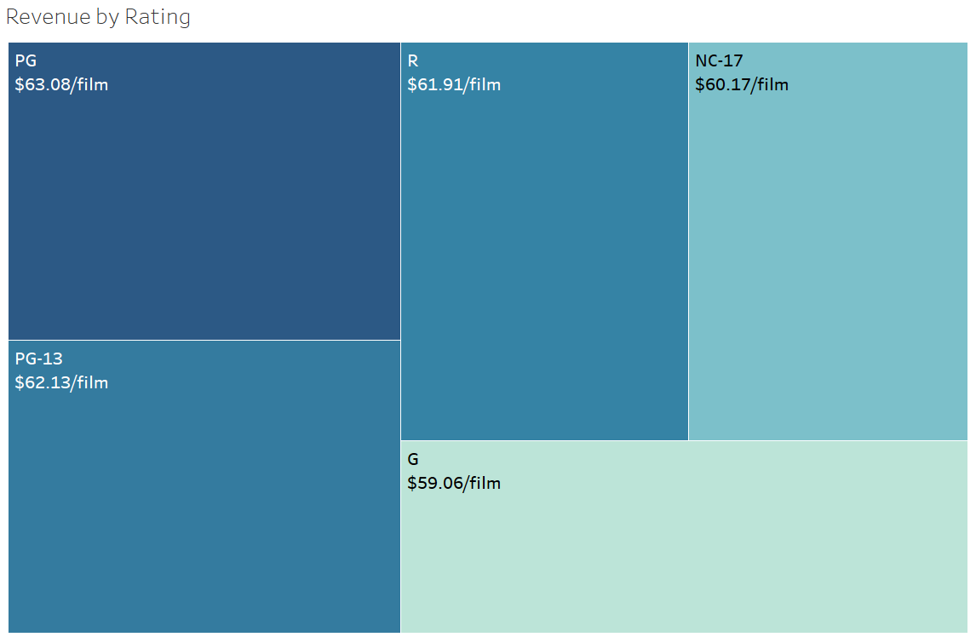

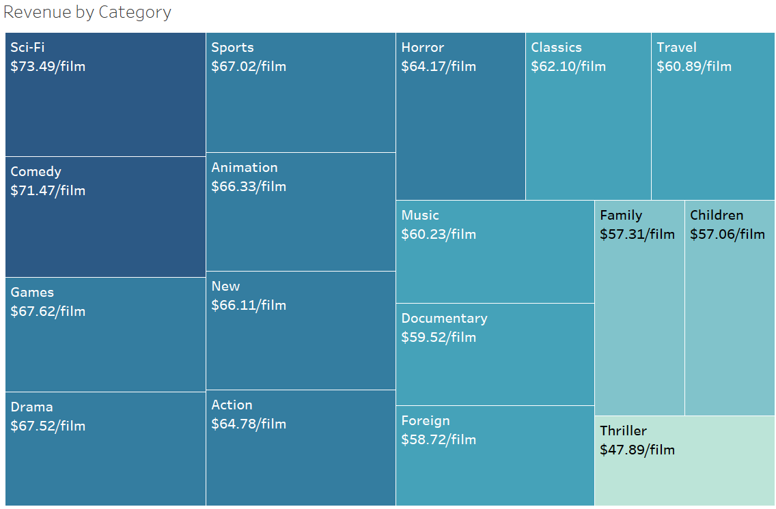
Revenue Breakdown per film
Revenues by rating are similar with PG earning most
Revenues by category were led by Sci-Fi and Comedy

Slide 5
Film inventory Statistics:
We have 958 different films in Rockbuster’s inventory that are all in English.
We have 4,581 film copies in inventory.
Our inventory contains from 2-8 copies of each film in 17 categories.
Rental Rates are $.99, $2.99, or $4.99.
We have 3 copies of only 1 Thriller title.
Rental Rates
min | $ 0.99
max | $ 4.99
average | $ 2.98
Rental Rate Duration
Min | 3
max | 7
average | 4.985
Film Length
min | 46
max | 185
average | 115.272
Replacement Cost
min | $ 9.99
max | $ 29.99
average | $ 19.98

Slide 6
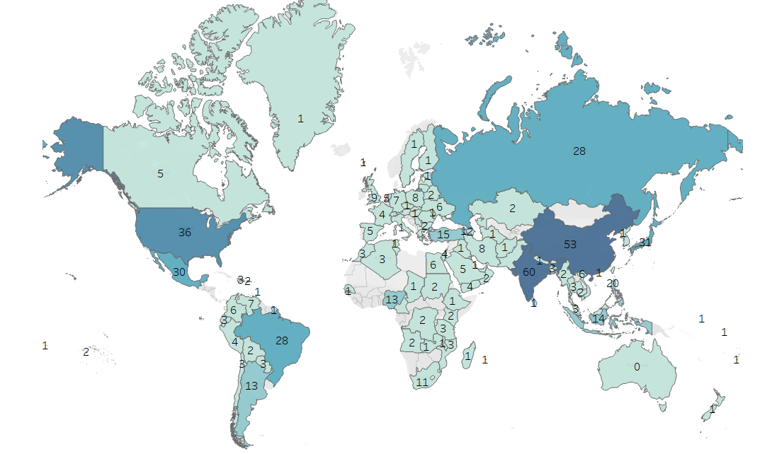
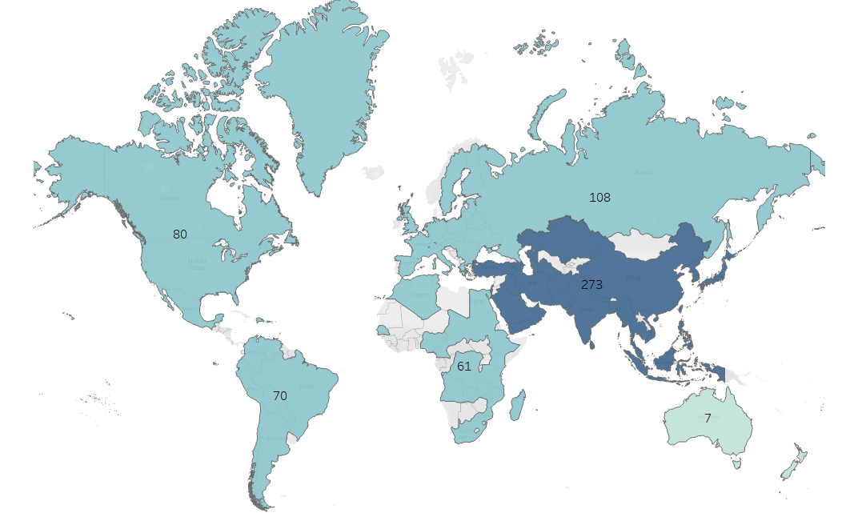
Where are Rockbuster customers?
All over the world! India has 60 customers.
With a concentration in Asia with 273 customers.

Slide 7
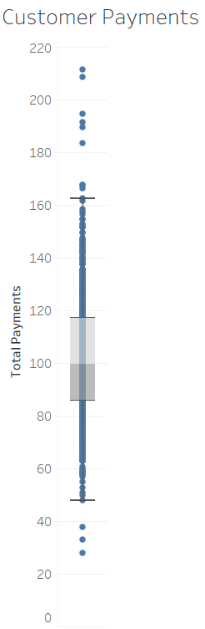
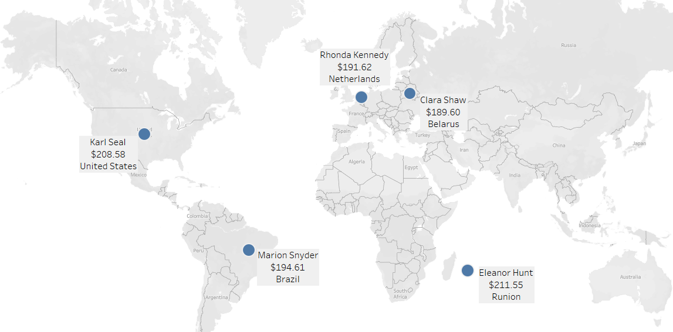
Top customer Locales
Our customers spent $27.93 - $211.55
With a median lifelong spend of $99.74
And average lifelong spend of $102.36

Slide 8
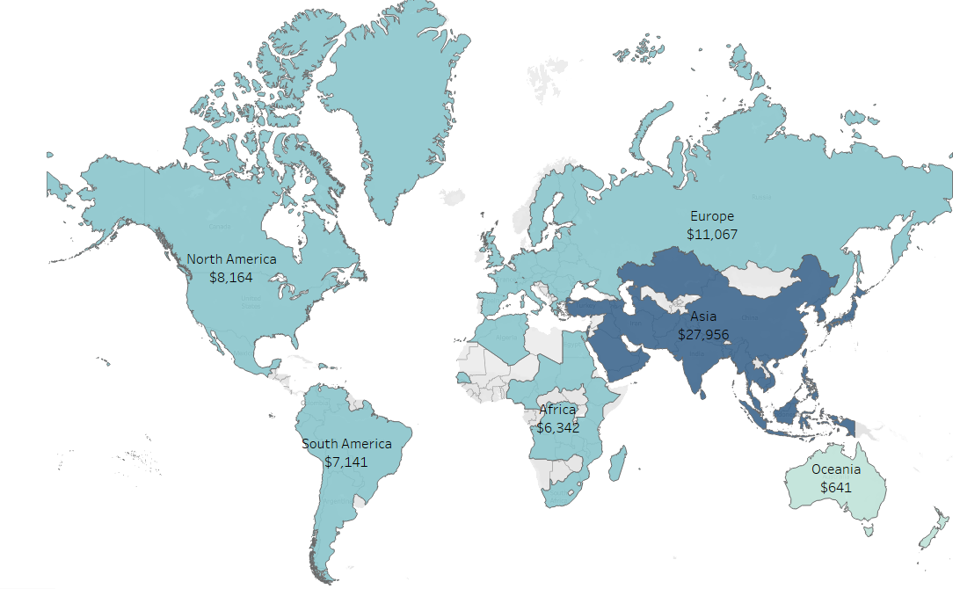
Sales figures by continent
Asia represents the continent with the most revenue earned with more than the Americas, Europe, and Oceania combined.

Slide 9
Recommendations/Conclusions:
Categorically, Sci-fi films contributed the most to revenue gain per film; however, the Musical, “The Telegraph Voyage” earned the most in revenue for one film.
Average rental duration for videos are 4.985 days. 6670/14596 paid rentals were returned late, incurring a late fee.
The top 5 countries for both # of customers and revenue earned are: China, India, Japan, Mexico, and the United States.
Customers with highest lifetime values live in Reunion, the United States, Brazil, the Netherlands, and Belarus.
Geographically, Asia has the highest concentration of customers and revenue earned. Oceania has the fewest customers and revenue earned.
Total revenue is $61,312, including late fees of $18,394.

Slide 10
Contact info
Questions? erhill555@gmail.com
Emily Hill, data analyst
Rockbuster stealth, LLC

